Slide 1

Welcome to the
GRADUATE REALTOR® Institute
Monitor Training
2014

Slide 2
Session Objectives
Become familiar with the new GRI program and requirements
Understand your role as a GRI Monitor
Familiar with the administrative process for a class
Understand the instructor role, process and standards
Resources: GRI website, Facebook and monitor resources
Notes:
I hope this program will help prepare YOU to serve as monitor or answer questions you may have if you are an existing monitor
Largely, we want to help you understand your role and what we expect from you
As a GRI monitor, you represent AAR. Although you may have been asked by your local association to serve, you are mainly representing AAR in your role.

Slide 3
Common Terms
Candidate
Someone who has started the GRI program, but has not earned the designation
Designee
Someone who has completed the program and earned the Designation
Provider
The entity authorized by AAR to offer a GRI class (local association, Arizona chapter of an NAR institute, society, council or firm)
Notes:
Lets start with a few key terms so we are all on the same page:

Slide 4
Years in real estate:
20% - less than 1 year
31% - 1- 3 years
23% - 4-6 years
13% - 7-10 years
13% - over 10 years
Age:
1% - under 25
10% - 25-34 years
18% - 35-44 years
34% - 45-54 years
37% - over 55 years
Who are the GRI Students

Slide 5
2014
Program and Requirements
ARIZONA ASSOCIATION OF REALTORS®

Slide 6
The New Curriculum
Curriculum is broken into two focus areas:
Skill Building
and
Risk Management
ARIZONA ASSOCIATION OF REALTORS®
Notes:
Members now have a better chance to build the GRI curriculum according to their needs.
For those that want online options – the REBAC classes offer online format (in addition to live classroom format)
For those that have earned NAR designations prior to earning the GRI designation – they now can be used towards their GRI designation
For those that have been in the business a while and may want to focus on the risk management aspect – they now can use the rCRMS classes toward their GRI designation

Slide 7
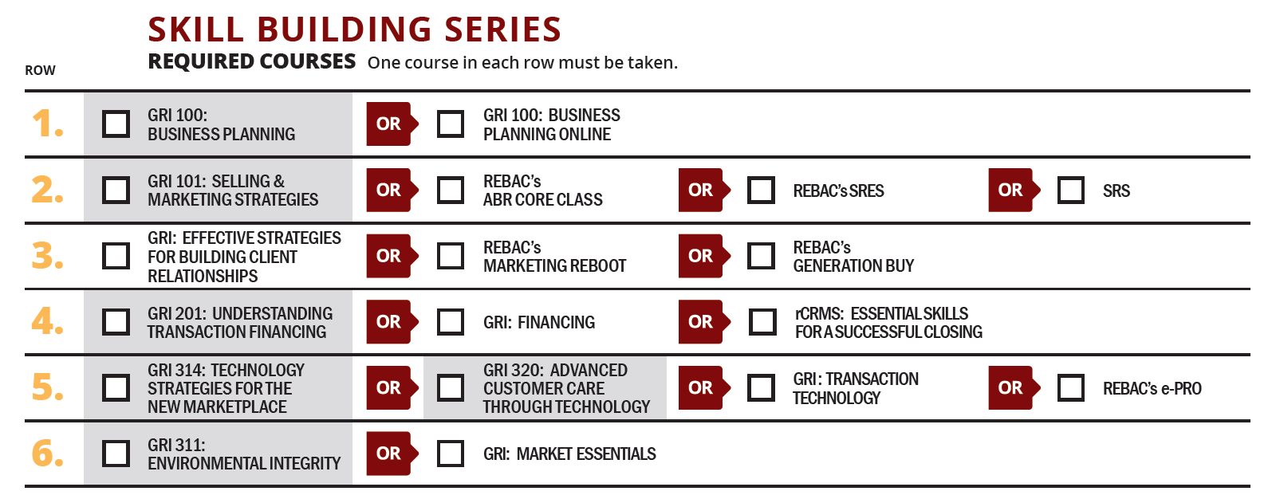
Curriculum Skill Building
Gray = not available in 2014
ARIZONA ASSOCIATION OF REALTORS®

Slide 8
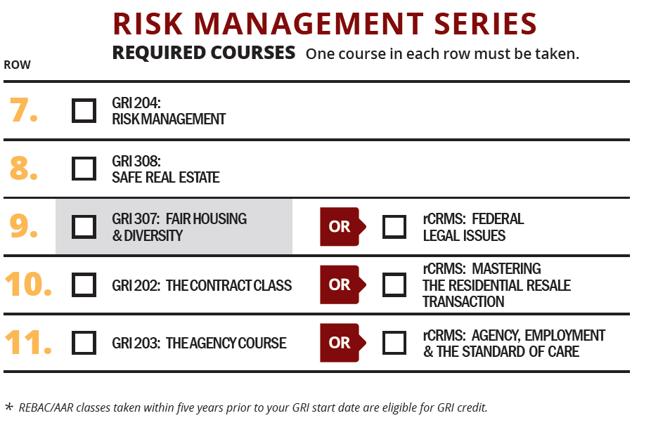
Curriculum Risk Management
ARIZONA ASSOCIATION OF REALTORS®

Slide 9
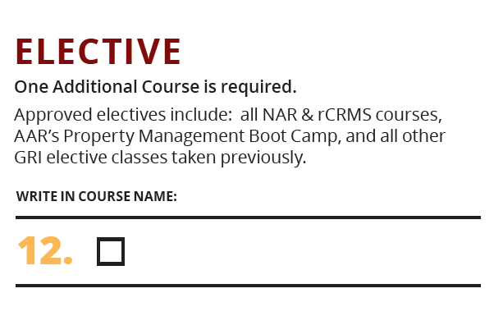
Curriculum Elective
ARIZONA ASSOCIATION OF REALTORS®

Slide 10
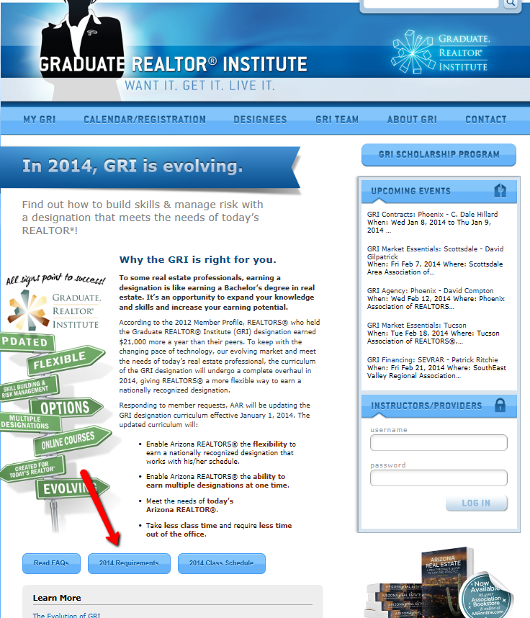
Where can you find this?
ARIZONA ASSOCIATION OF REALTORS®
Notes:
www.AZgri.com homepage

Slide 11
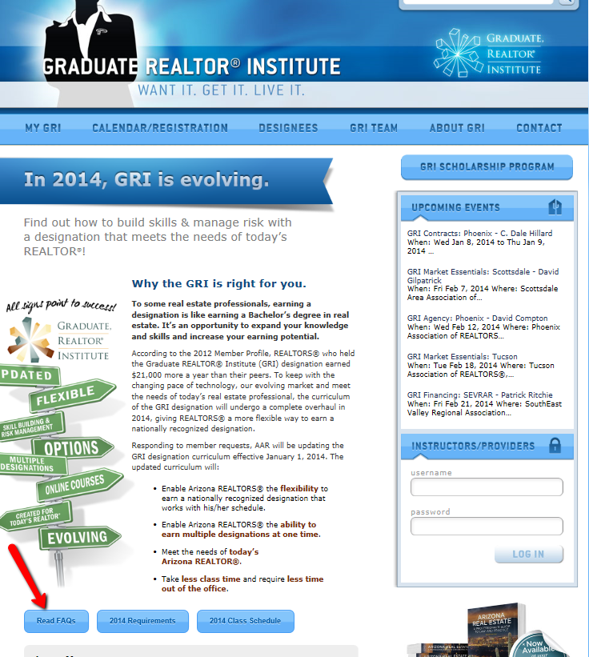
Resource to help members understand:
ARIZONA ASSOCIATION OF REALTORS®
Notes:
FAQ containing frequently asked questions

Slide 12
Monitors: Your Role
ARIZONA ASSOCIATION OF REALTORS®

Slide 13
ROLE OF A GRI MONITOR:
Manage the classroom environment
(room temperature, attendance, distractions)
Assist the Instructor (break reminders, pass out handouts, if needed)
Provide feedback to AAR (curriculum and instructors) – MOST IMPORTANT
Answer student questions about the program and the designation
Notes:
MOST IMPORTANT: Provide feedback to AAR

Slide 14
Interrupt or correct instructors during class
Read the newspaper in back of room and not pay attention
Talk in the back of the room – disruptive
Not notice students using electronics
Be too stiff or militarian in introductory remarks
Be cautious not to:

Slide 15
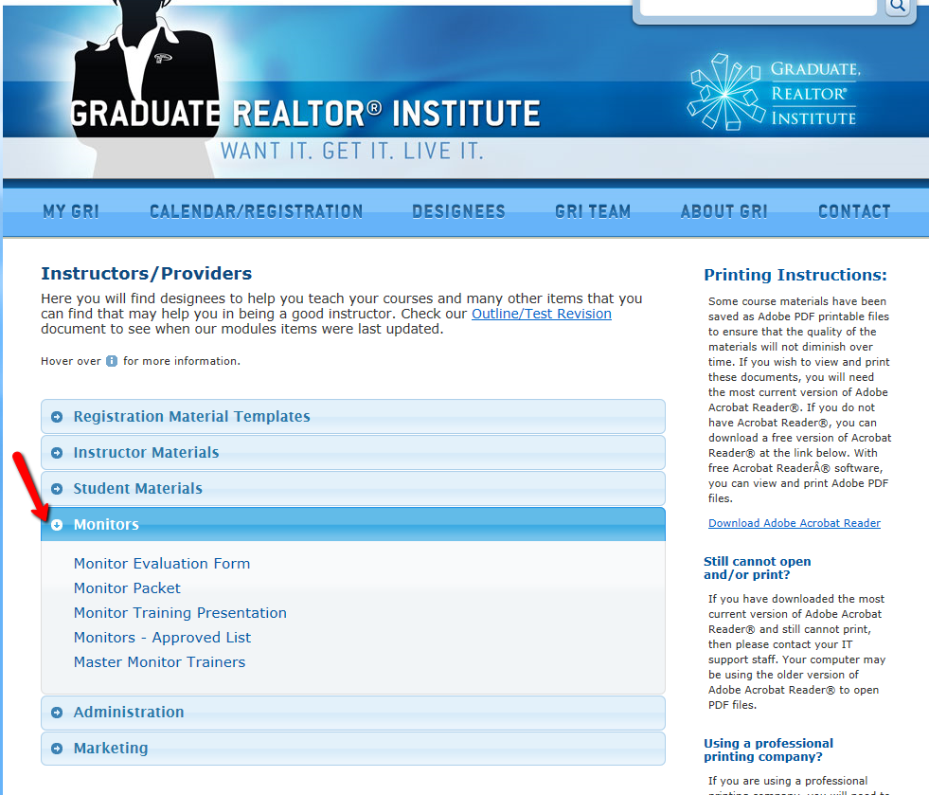
All monitor information including evaluation forms can be downloaded from www.azgri.com website.
Monitor Resources

Slide 16
Your association staff will give you the monitor packet when you accept a class assignment or you can download it from www.azgri.com

Slide 17
Monitor Evaluation Form
After lunch, you should start filling out your form

Slide 18
Importance of the Monitor
Evaluation Forms
You are our eyes and ears….
AAR staff and volunteers are not in the classes - we rely on student and monitor feedback to provide us with information to help us effectively evaluate the program.
Notes:
Updates to curriculum made based on student feedback
Instructor’s continued participation in GRI program based on student and monitor feedback

Slide 19
AAR defers to your evaluation form specifically when student coments indicate:
Curriculum is outdated
Instructor did not have control of the class
Instructor had trouble with the material
Instructor told inappropriate jokes
PowerPoint is hard to read
Students disruptive in class

Slide 20
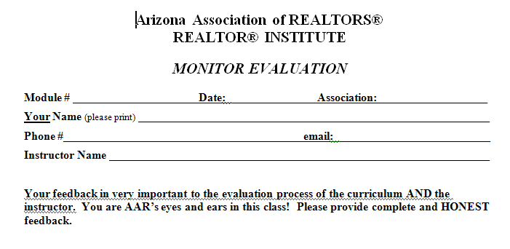
Lets review the form:

Slide 21
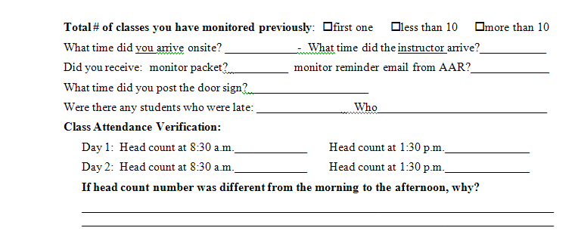
Notes:
The instructor delivery should be addressing all types of learners
Studies show
22% of learners are Auditory :
need to HEAR things
like instructor telling stories
20% of learners are Tactile:
need to write down information – take notes
Learn by performing
12% are kinesthetic:
Need to “do” – trial by error
Need to move around
Like case studies and field trips
46% of learners are visual:
Need to see something - handouts/student workbooks
Like to take notes on handouts

Slide 22
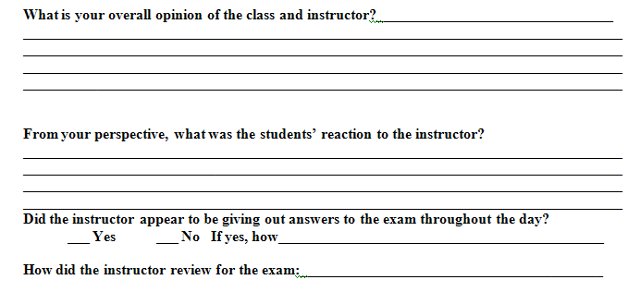
Notes:
Adult learners want information they can apply directly to their work.
Theory is useful only when participants know how to use it. Connecting the dots for the students is one of the major goals of the GRI curriculum. We look to you to help us gauge this area.

Slide 23
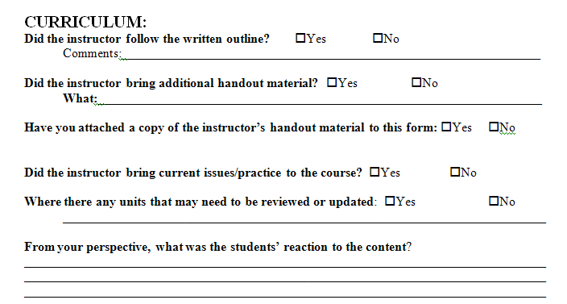
Notes:
Often times, we see student comments pertaining to an issue. We then look at the monitor evaluation and nothing is mentioned.
Example: multiple students commented that instructor did not follow the outline, instructor was all over the board, it was difficult to follow the instruction, the powerpoint did not flow with the outline. The monitor comment on the form simply read “good”

Slide 24
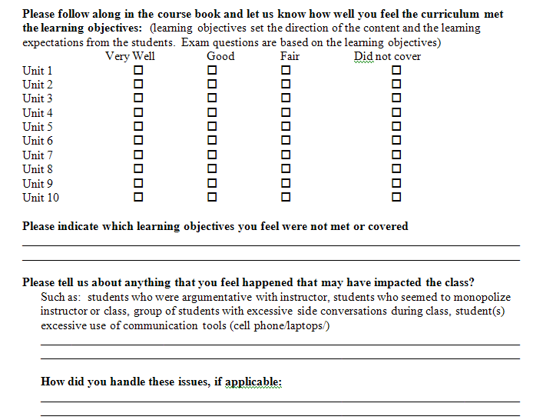

Slide 25
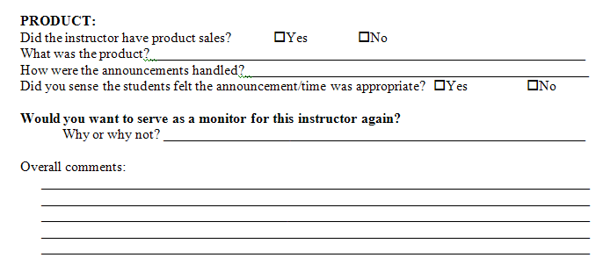

Slide 26
Triggers to update or revise a class:
Initial idea/suggestion can come from:
student comments
monitor comments
workgroup
Instructor
Process:
Step 1: Idea sent to the instructors for feedback
Step 2: Staff reviews and makes recommendations to Oversight Group
Step 3: If approved, staff begins the work

Slide 27
Program Administration
Notes:
Often, the course provider will print extra sets of materials above the number of students registered for walk-ins. If you run out of material, the materials can be downloaded from www.azgri.com and copied in house.

Slide 28
Class Materials
All class material is posted on the GRI website (administrator section)
(books, reference material if any, sign in sheets, c/e certificates.)
Your association staff will download the materials from www.azgri.com prior to the class
Notes:
Often, the course provider will print extra sets of materials above the number of students registered for walk-ins. If you run out of material, the materials can be downloaded from www.azgri.com and copied in house.

Slide 29
The Day of the Class
Arrive onsite at least 30 minutes prior to the class unless your course provider indicates otherwise

Slide 30
Find out from your association staff:
Who will introduce the affiliate sponsors and when?
(Sponsor remarks should be given prior to class start - suggestion: 7:50-8:00, breaks and/or lunch – ADRE does not permit sponsor remarks during the “class time”)
Who will handle the student check-in?
Notes:
Also important to know how it will be handled if sponsor takes up too much time

Slide 31
Welcome the Instructor
Introduce yourself and…
Find out from the instructor:
What type of assistance he/she may need from you.
Who will do the introductory remarks and instructor introduction.
How instructor wants to handle breaks: pre-arranged or spontaneous?
If the instructor wants you to signal him/her when it is break time?

Slide 32
How does he/she prefer you handle the following:
disruptive students
phones going off in class
hecklers
air temperature complaints

Slide 33
CLASS ANNOUNCEMENTS:
(if you are making the announcements)
Welcome the Students
Introduce instructor
(unless instructor wants to self-introduce)
Go through housekeeping items
(script is available in the monitor packet, if needed)
Recognize first-time students
Recognize ALL students who are taking their last class
Remind students to fill out “Last Class” form

Slide 34
Door Signs
Do not post on the door prior to 10/20 minutes after instructor starts.
Notes:
If signs are posted earlier, it may discourage a student who is a few minutes late to turn around and leave.

Slide 35
Students will not receive c/e or GRI credit if arriving:
Late to Class
more than 10 minutes (1 day class)
20 minutes (2-day class) after the instructor starts teaching

Slide 36
Exceptions to the late policy for GRI credit can only be made by the AAR staff in conjunction with the GRI workgroup chair.
Advise the student he/she may attend the class but will not receive c/e or GRI credit.
Student can appeal to AAR (although AAR consistently adheres to this policy)

Slide 37
TIP: For Late Students:
Write the arrival time on the sign-in sheet and have the student initial it.
Notes:
This helps defuse any arguments after the class

Slide 38
Sign-in sheet:
Pass the sign-in sheet around in the morning
AND in the afternoon
Ask the students to check their email address
(as the monitor, you need to sign the bottom of each sign-in sheet page prior to the end of class)

Slide 39
Changes made to the sign-in sheet are only for the purpose of AAR class contact information – they do not change the information in the membership database.
If the student does not make the change with their local association, the contact information in the AAR database will continue to be incorrect.
If you have any students in class just for the c/e, please mark CE ONLY next to their name on the sign-in sheet.

Slide 40
Breaks/Lunch
After each break make sure everyone is back in class when the class starts.
Tips:
A bell or buzzer helps everyone return promptly
Shut the doors
Flicker the lights
Count heads again!

Slide 41
Tip: Make yourself a floorplan:
(sample based on three rows across – change to fit your setup) after start of class
_____ ______ ____
1st break
_____ ______ ____
2nd break
_____ ______ ____ after lunch
_____ ______ ____
1st break
_____ ______ ____
2nd break
_____ ______ ____

Slide 42
Continuing Education Certificates:
C/E certs should be given to students at the end of class as they leave.
Notes:
Templates are provided by AAR to the course provider.
Course providers fill in the students names.

Slide 43
And my last class is…
Student who are taking their last class should fill out the completion form located in the student book and either mail or fax it to AAR or give it to you to send back to AAR
ARIZONA ASSOCIATION OF REALTORS®
Notes:
Article appearing in August AZR
Email will be sent to current candidates next week

Slide 44
New designees:
Receive a package congratulating them from AAR containing designation information.
Their certificate and pin is mailed directly to the student or the local association at the end of the month.

Slide 45
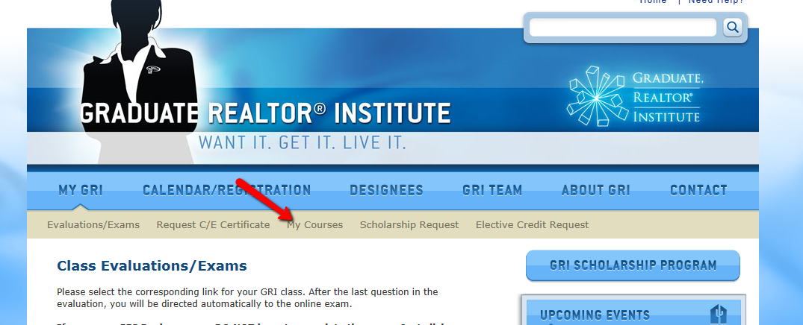
Student Course History
Notes:
Students can look up their own course history. (only native GRI courses will be listed)

Slide 46
Student Evaluations
Class evaluations are completed online via Survey Monkey.
Students will access the evaluations on the AZGRI website under the My GRI page.
Please stress to them that the survey and exam MUST be completed within 48 hours of the class.
Successful completion of the module will not be valid until the student completes an Instructor evaluation and the exam.
(The exam link is contained at the end of the evaluation.)
Notes:
The first page of each student book contains this information

Slide 47
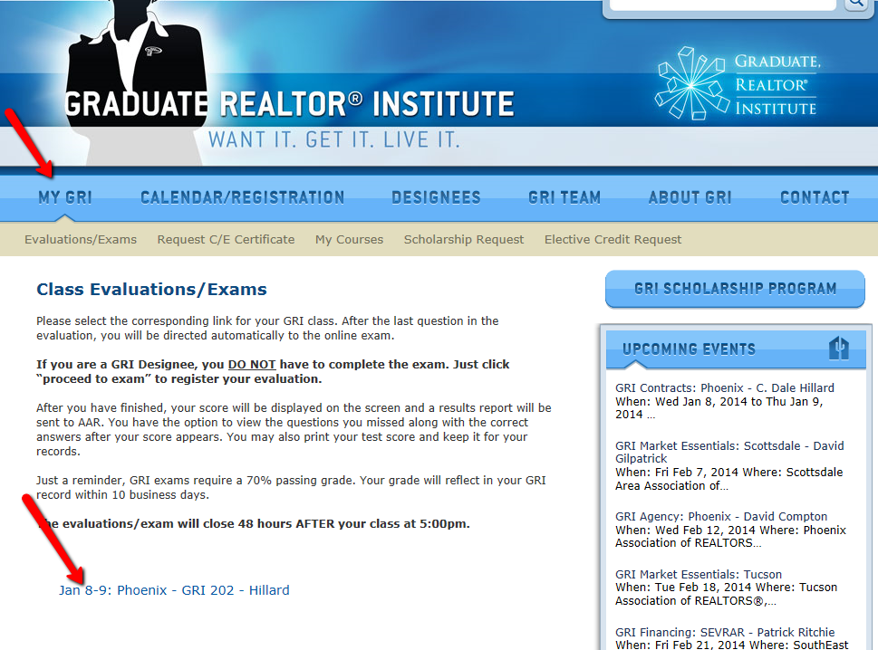
Student Evaluations
Notes:
Class evaluations are completed online via Survey Monkey.
Students will access the evaluations on the AZGRI website under the My GRI page.
Please stress to them that the survey and exam MUST be completed within 48 hours of the class.
Successful completion of the module will not be valid until the student
completes an Instructor evaluation and the exam.
(The exam link is contained at the end of the evaluation.)

Slide 48
Exam: Why?
Exams are given in the GRI program to measure the student’s comprehension of the material.
Exam questions correlate to the learning objectives in each of the units.
Instructors conduct a review during or at the end of class. It is permissible for instructors to emphasize exam content during class.
The online exam is open book

Slide 49
We use an online format for the exams.
Students complete the online evaluation form which automatically takes them to the online exam at the end of the class evaluation.
Exam Format

Slide 50
Exam:
There is no time limit for completing the test once student starts it.
Students will receive their grade immediately upon finishing their online exam.
They can print out their grade if they wish for their files.
Students will see which questions they answered incorrectly and see the correct answer.

Slide 51
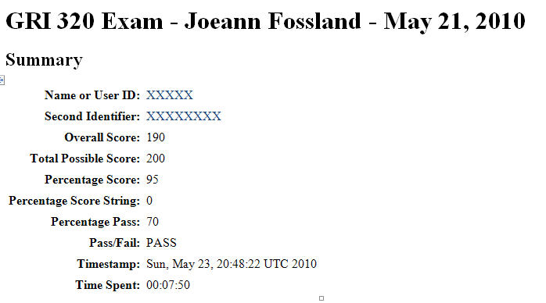
Example of Student Exam Result Screen

Slide 52
If a student fails the exam, the exam can be retaken within 30 days for a fee of $25.00
Instructors will receive notice of students failing an exam.
Students may contact instructors for counsel prior to retaking the exam.
Exam Failures

Slide 53
After the class, the association will return to AAR:
Sign-in sheets SIGNED BY THE MONITOR
Instructor Evaluation form (filled out by monitor)
Administration/Logistics Feedback Form (filled out by instructor & association staff)
GRI Completion Forms (if students turn them in)
Notes on any unusual circumstances such as someone is ill and must leave:
Notes:
Your course provider may ask your assistance in boxing this material up.

Slide 54
Instructors

Slide 55
We want our instructors to:
Provide current information and follow the outline
Clearly identify opinions as the instructor’s opinions
Build a foundation for each major element of a subject
Deal with all key elements of a subject
Cover the material adequately in the allotted time
Be informed enough to handle a variety of questions on the subject

Slide 56
Encourage questions and involvement
Involve learners in the learning process
Use a variety of teaching methods
Provide current and relevant material
Follow the prepared outline
Be positive toward the subject matter

Slide 57
Teaching to the generations
Baby Boomers:
Involve them – draw on their experience
Generation X:
Use diverse methods, validate why student should know the information – how can they apply it
Generation Y:
Challenge them, engage them, inspire them, show the relevancy
Notes:
Not only do we have learning styles to consider, we have generational styles to consider. It really does take talent to educate to today’s students in today’s environment.

Slide 58
The more learners are actively engaged in the learning process
(discussing, writing, imitating, questioning, practicing, doing, and the like), the more they are able to remember!

Slide 59
Probably the most significant characteristic of adult learners – and the characteristic that separates the adult learner from children – is the adult’s need and desire to see the real-world relevance (of what’s being taught) to his or her life.

Slide 60
Common Challenges You May Face

Slide 61
Challenge:
Getting students back in class after each break.
Suggestion:
flick the lights on and off if your room allows
ring a bell
play music during the break and turn off
when class is starting back up

Slide 62
Challenge:
Class started late due to length of registration had problems with the flow of sign-in sheet.
Suggestion:
Ask instructor if he/she wants to delay start time 5 minutes

Slide 63
Challenge:
Student arrives late.
Suggestion:
If after the 10/20 minute timeframe, note the time on the sign-in sheet in front of the student and advise student he/she will not be able to receive the c/e and GRI credit and give opportunity to transfer to another class (if your assn staff agrees)

Slide 64
Challenge:
Student who didn’t come back from a break or lunch.
Suggestion:
Count heads after lunch to determine if all came back. If missing, send sign in sheet around right away to identify who did not come back from lunch.

Slide 65
Challenge:
Complaints from the students about the instructor.
Suggestion:
Talk with instructor during a break to alert instructor to the student concerns.

Slide 66
Challenge:
Student’s phone goes off.
Suggestion:
Tap student on shoulder and ask to turn off. If continues, advise student next time it goes off you will take and hold until after class..

Slide 67
Challenge:
Student texting during class.
Suggestion:
Tap student on shoulder and ask to turn device off. If continues, advise student you will take and hold until after class.

Slide 68
Challenge:
Students having side conversations.
Suggestion:
During break, advise students they are disruptive and suggest one or more move seats.

Slide 69
Challenge:
The instructor has product to sell…and wants to set up product in front of class?
Suggestion:
Get course provider involved! Product should not be set up in front of class. You should NOT set up product for the instructor.

Slide 70
Challenge:
Not enough material for all the students.
Suggestion:
Ask Assn staff to make copies (materials can also be downloaded from the www.azgri.com website.

Slide 71
Common questions Monitors may receive from students

Slide 72
Q. How long do students have to complete all the courses?
A. All courses must be completed within five years from the date of the student’s first course.

Slide 73
Q. If student is not a REALTOR® yet, can he/she still take the classes?
A. Yes, although only active NAR members may earn the GRI designation. The classes will be activated once the student’s membership becomes active.

Slide 74
Q. Is there continuing education (c/e) credit for these classes?
A. Yes, most of the classes have been approved by ADRE for c/e credit. Specific c/e is noted on the module description page and at www.AZGRI.com
Notes:
The technology and customer service classes do not offer c/e credit

Slide 75
How long will it take before students find out if they passed the exam?
A. Immediately upon finishing the online exam.

Slide 76
When does the student have to take the exam?
A. Within 48 hours after the class.

Slide 77
A student is not sure what classes he/she still needs, how can he/she find out?
A. Members can look up their GRI class records on the www.azgri.com website.

Slide 78
This is student’s last class, what does he/she need to do?
A. Fill out the Completion Form which will be provided by the association staff. The form should be turned in to the monitor when student leaves class
(if student can’t remember exact dates of classes taken, put in the year and location)
Notes:
Remember, students can look up their GRI class records on the www.AZgri.com website

Slide 79
A student attends the first day of the class, but can’t attend day two….can the student take the second day at another offering?
A. No.

Slide 80
Resources

Slide 81
Join the Arizona GRI Facebook?
https://www.facebook.com/groups/157505041546/

Slide 82

Spread the word: Scholarships
2014: $15,000 targeted for GRI Scholarship
Get Smart
Class scholarship
Spread the Word: Talk to the agents in your office – let them know about this opportunity
ARIZONA ASSOCIATION OF REALTORS®
Notes:
Brittni – review the criteria and how to apply for a scholarship and where folks can find scholarship information/application on website

Slide 83
Complete set of Monitor materials can be downloaded from www.azgri.com

Slide 84
Student Resources found on www.azgri.com

Slide 85
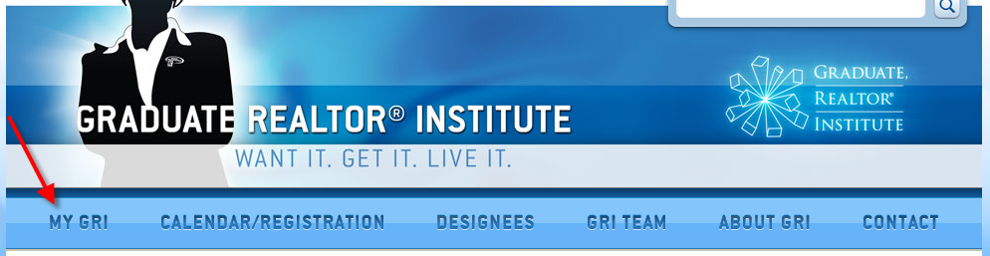
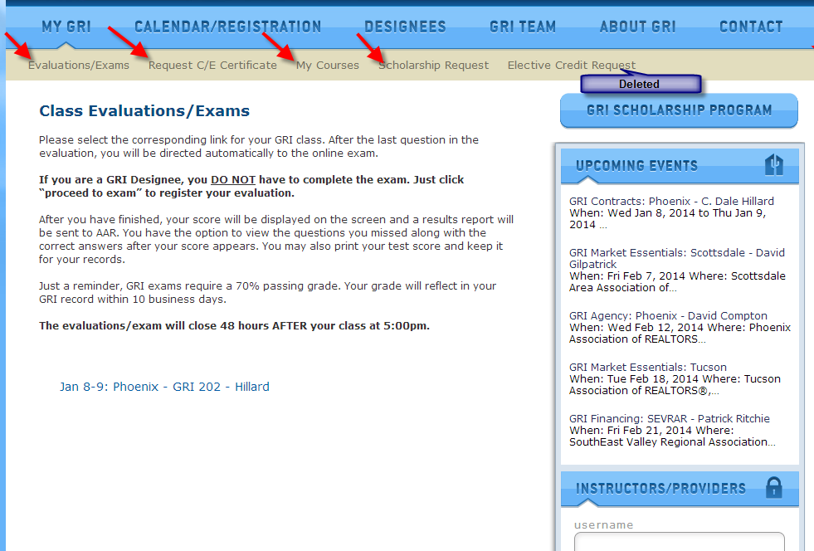

Slide 86
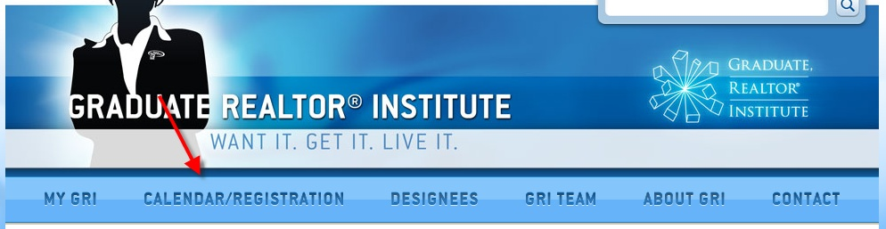
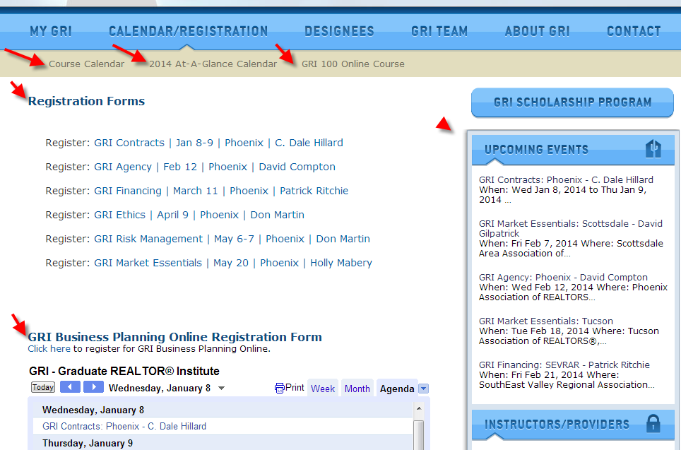

Slide 87

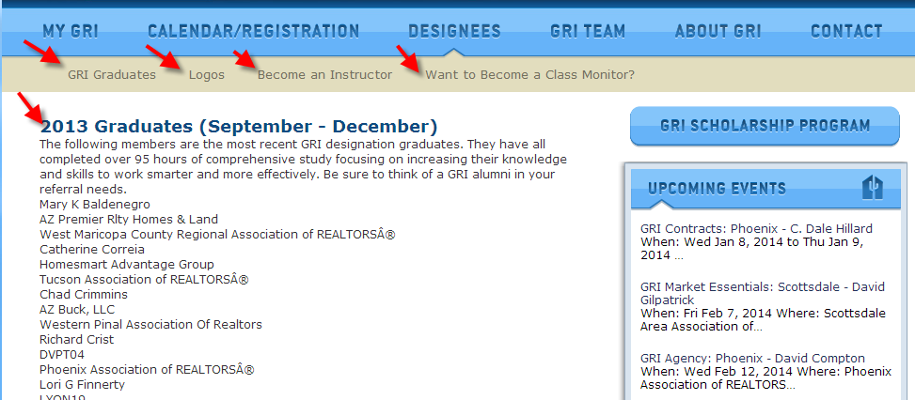

Slide 88

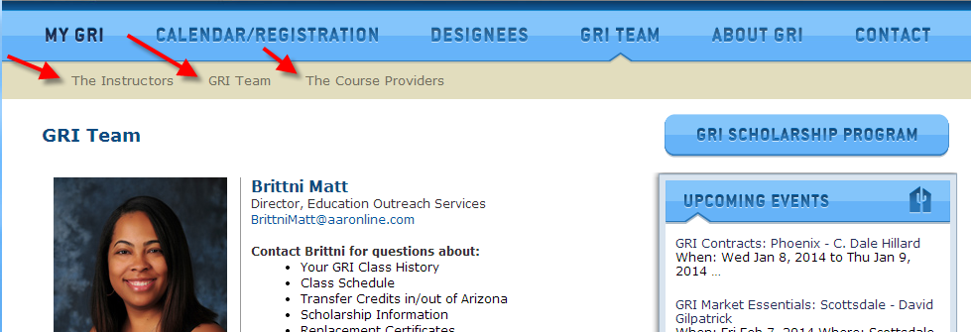

Slide 89
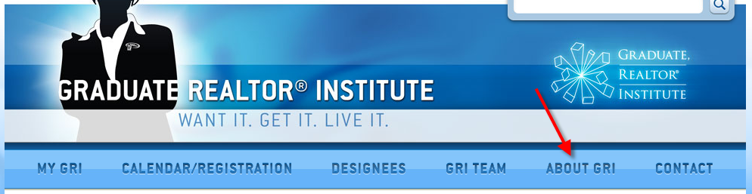
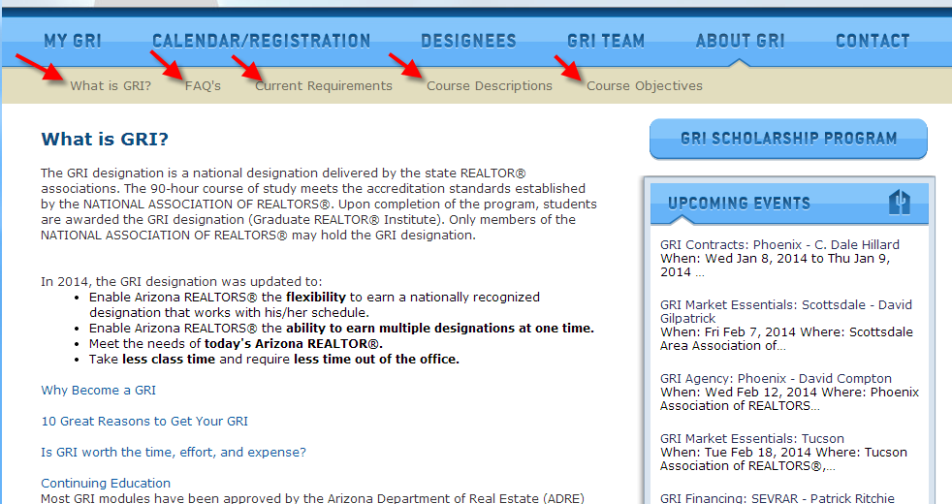

Slide 90
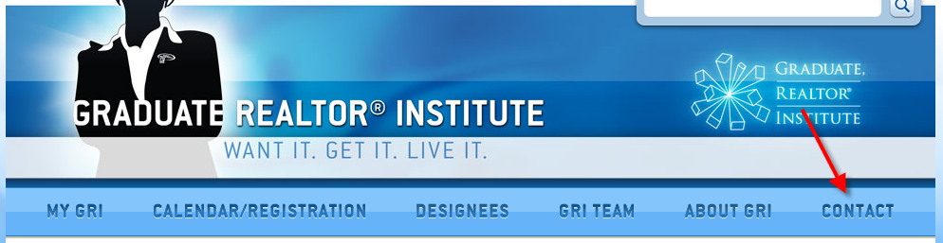
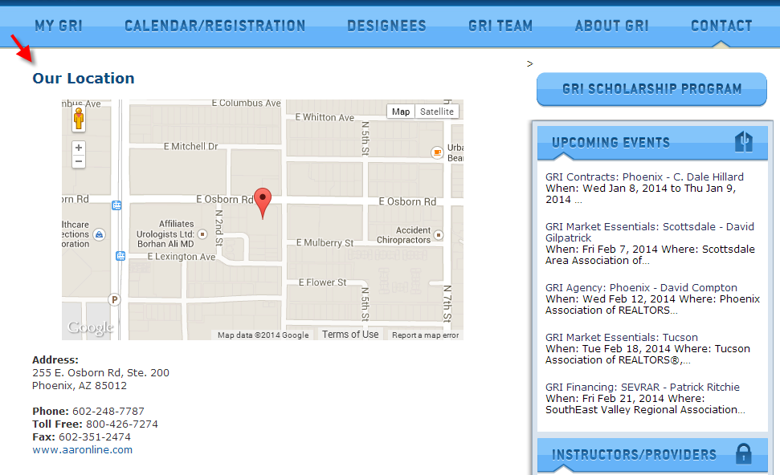

Slide 91
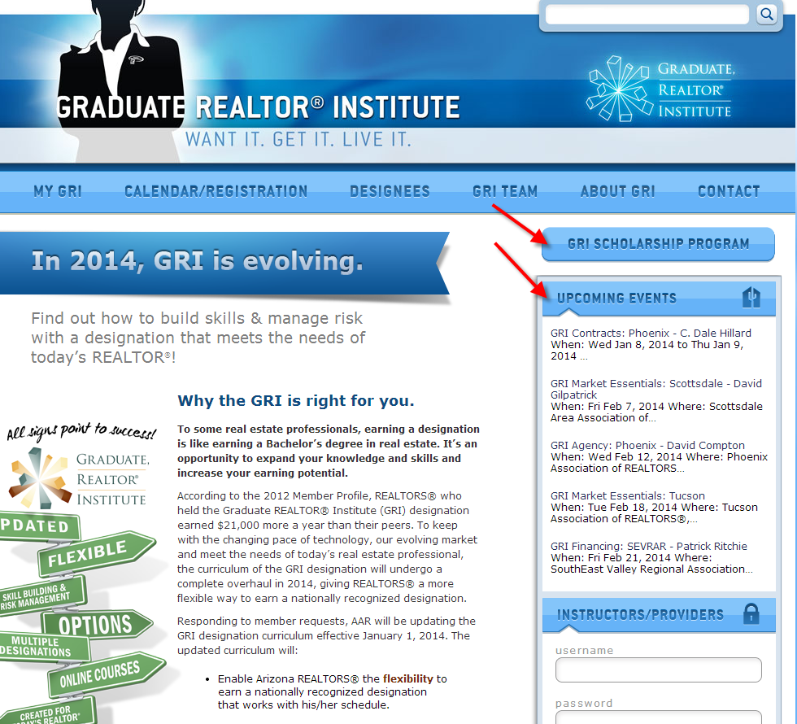

Slide 92
Now What?

Slide 93
How do I get assigned to monitor a
GRI class?
AAR will add you to our Approved Monitor List and notify the local associations that you are now approved to monitor.
If you are interested in working with neighboring associations - contact the local associations in your area and let them know your interest and availability
Shadow a monitor before you monitor your first class (talk to you association about this)

Slide 94
Remember …
The learning is truly what matters most, more than instructor popularity, more than whether or not you are liked by the instructor or students and more than whether the students simply “feel good” after their time in the class.

